Slide 1
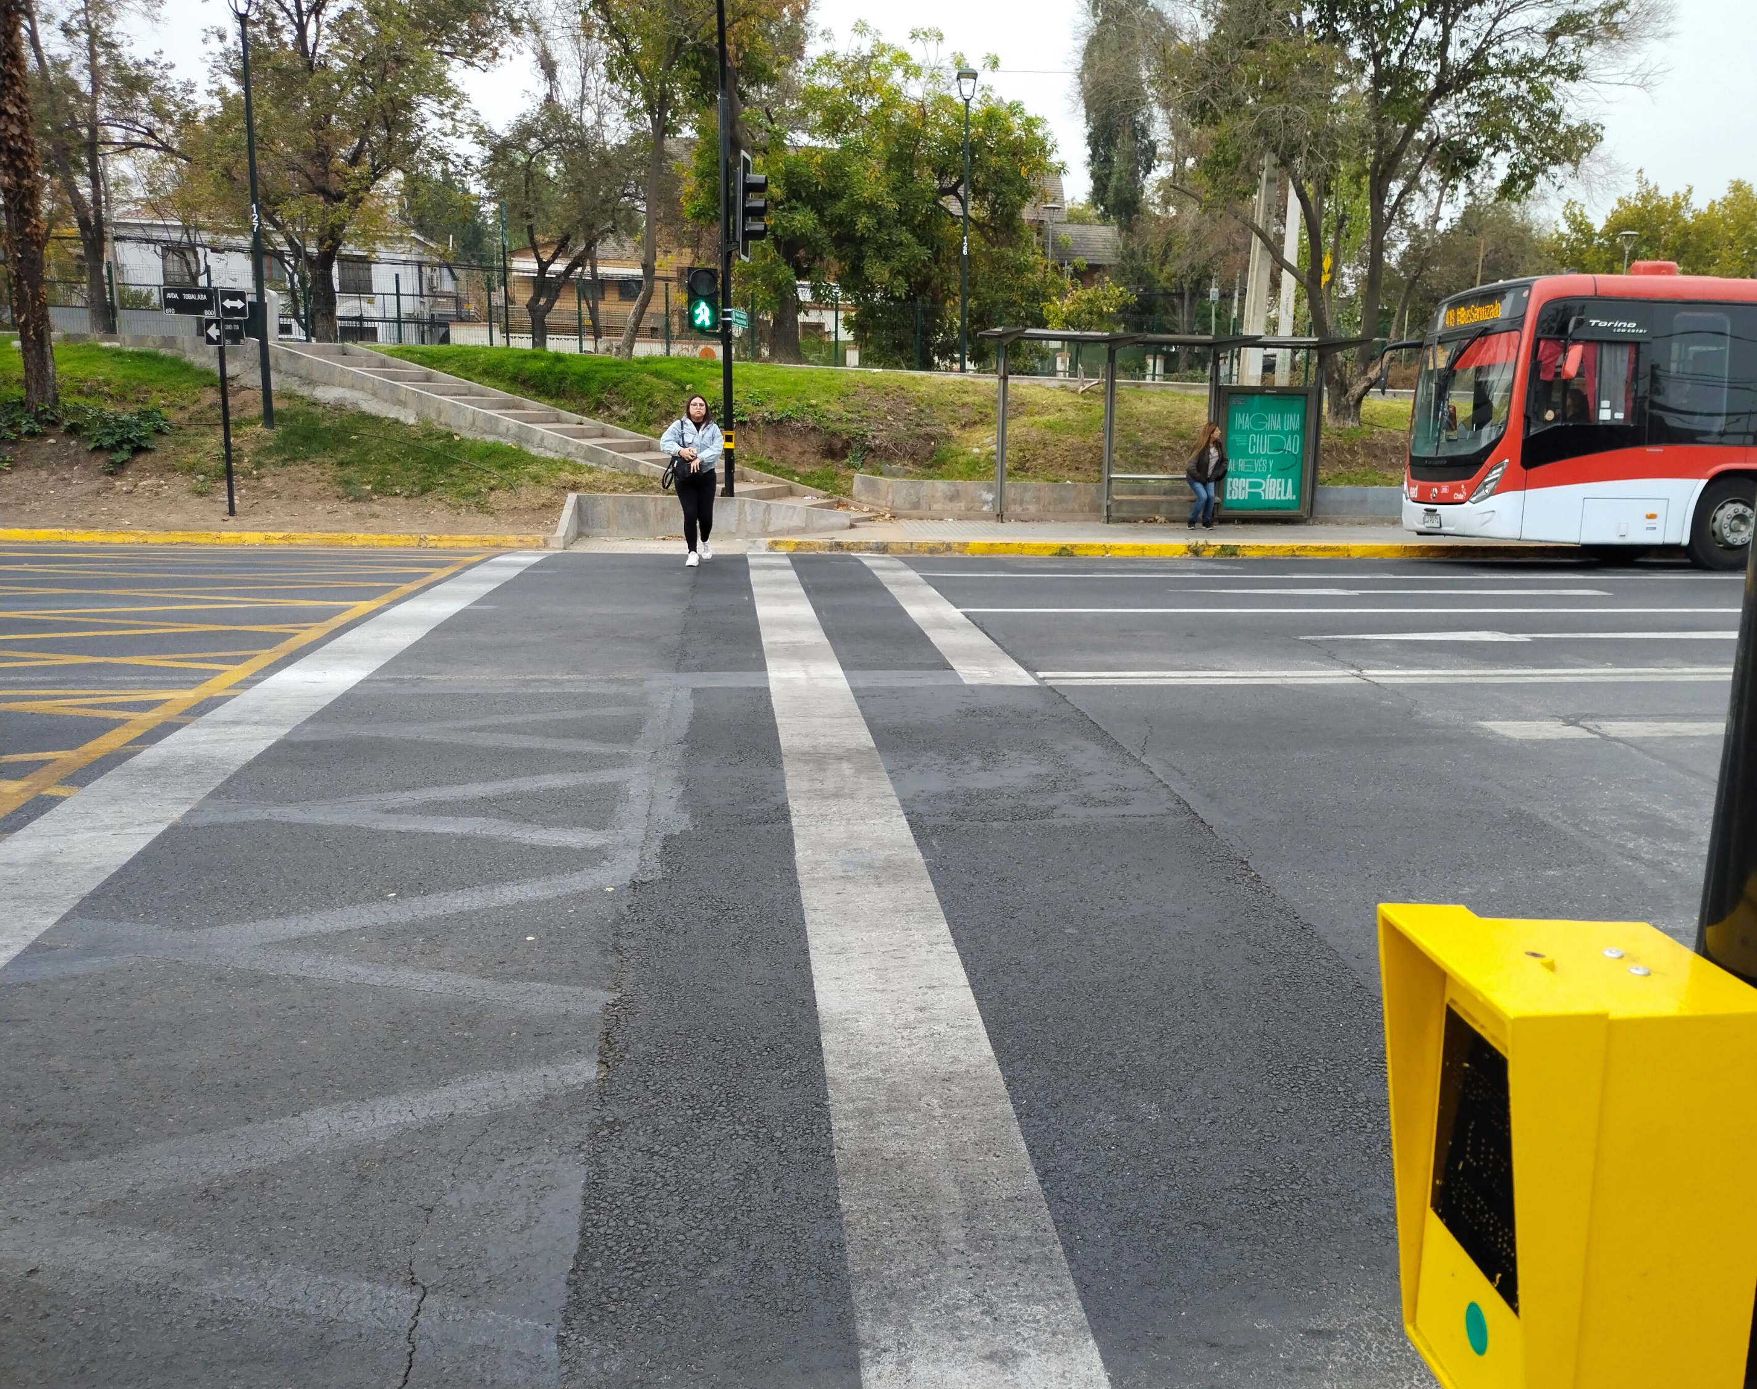
Master - Final Thesis Public Transport road safety risk for pedestrians and cyclists? Case Study of Santiago de Chile
Final Thesis developed by: Rimbaud, Axel
Directed by: Estrada, Miquel
Master in: Urban Mobility
Barcelona, 17th of July 2023

Slide 2
Thesis
2

Slide 3
Context

Slide 4
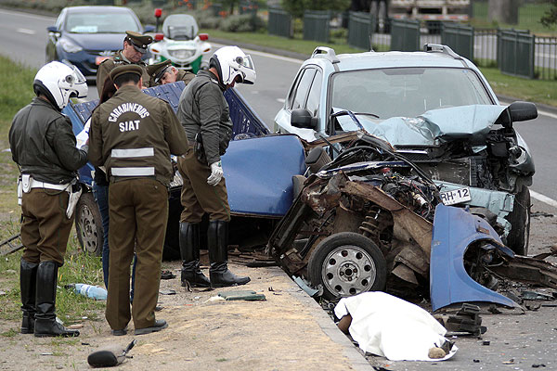
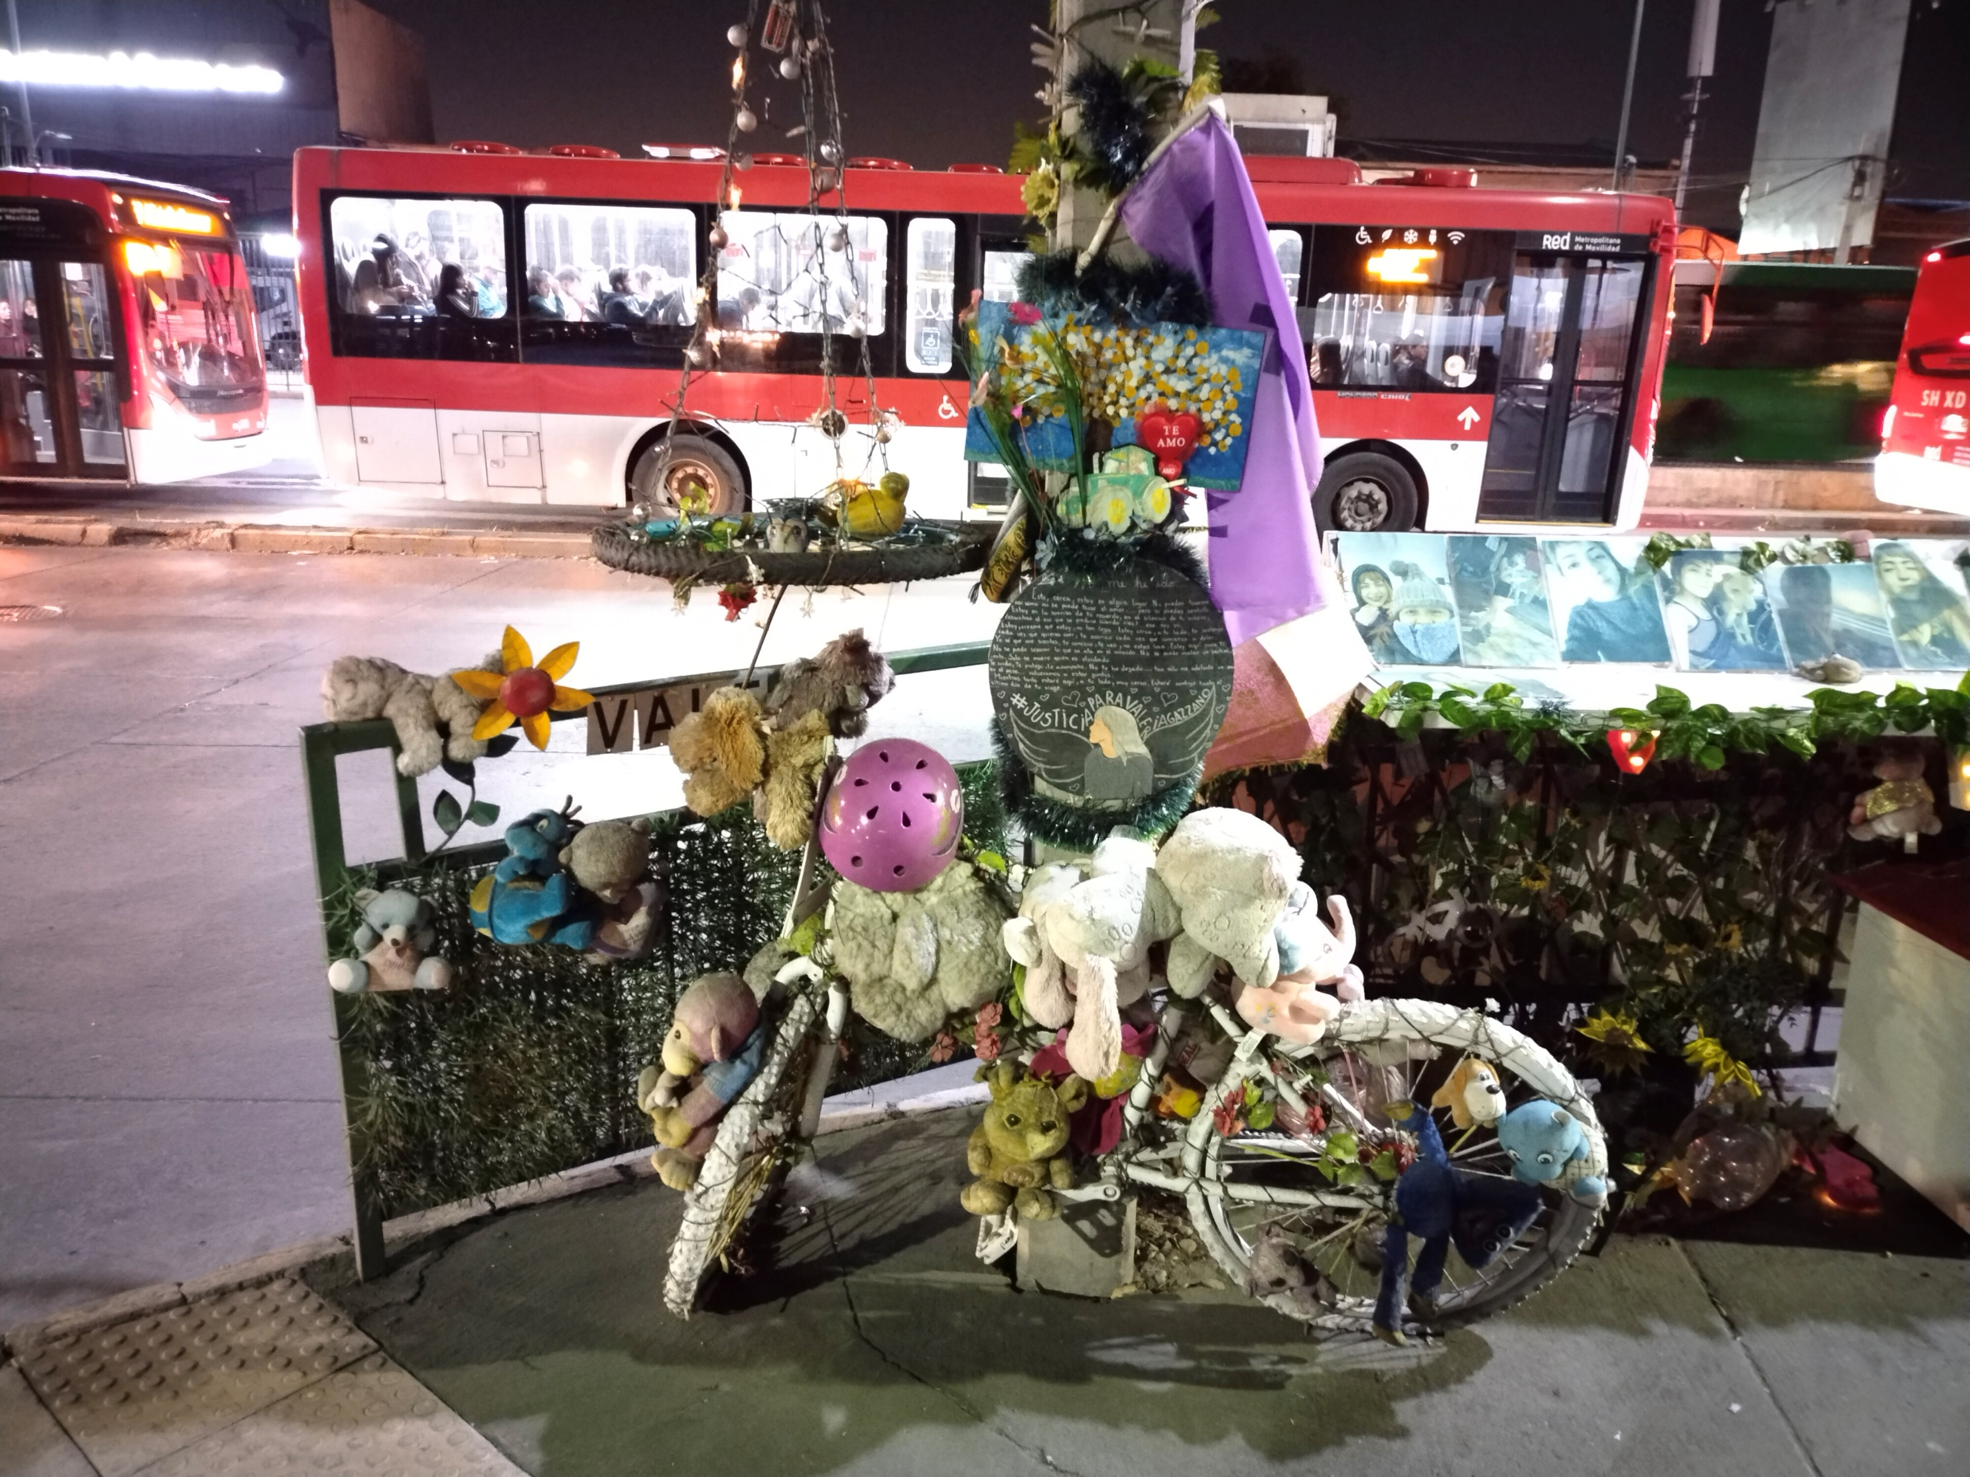
Road Safety
1.35 million deaths each year
30-50 millions serious injuries
#1 cause of death for children and young adults (5-29 years of age)
#8 cause of death in total
Source: WHO, 2018, Global Status Report on Road Safety
4

Slide 5
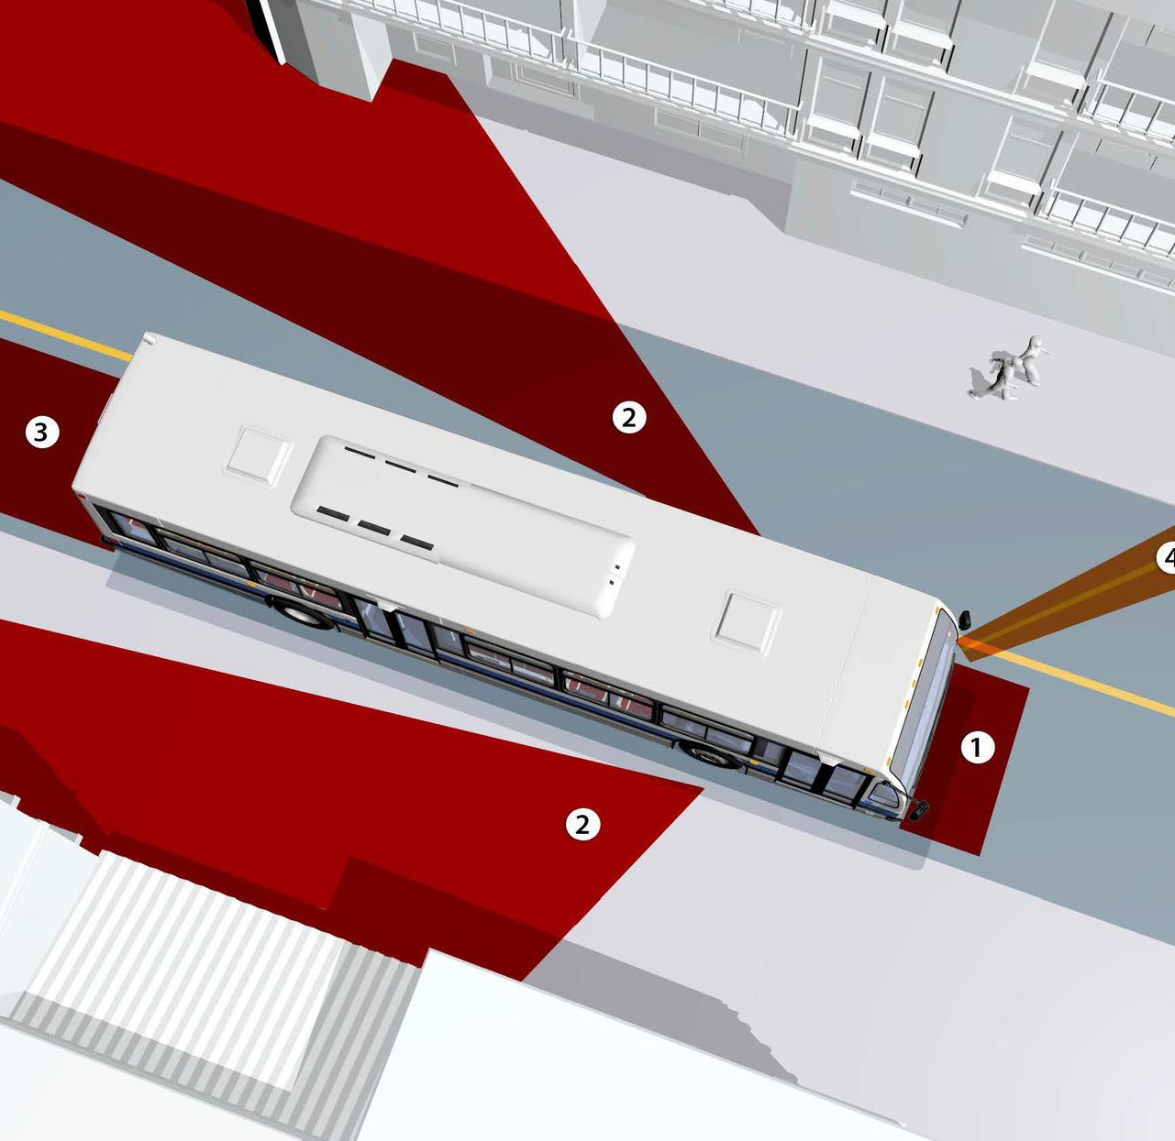
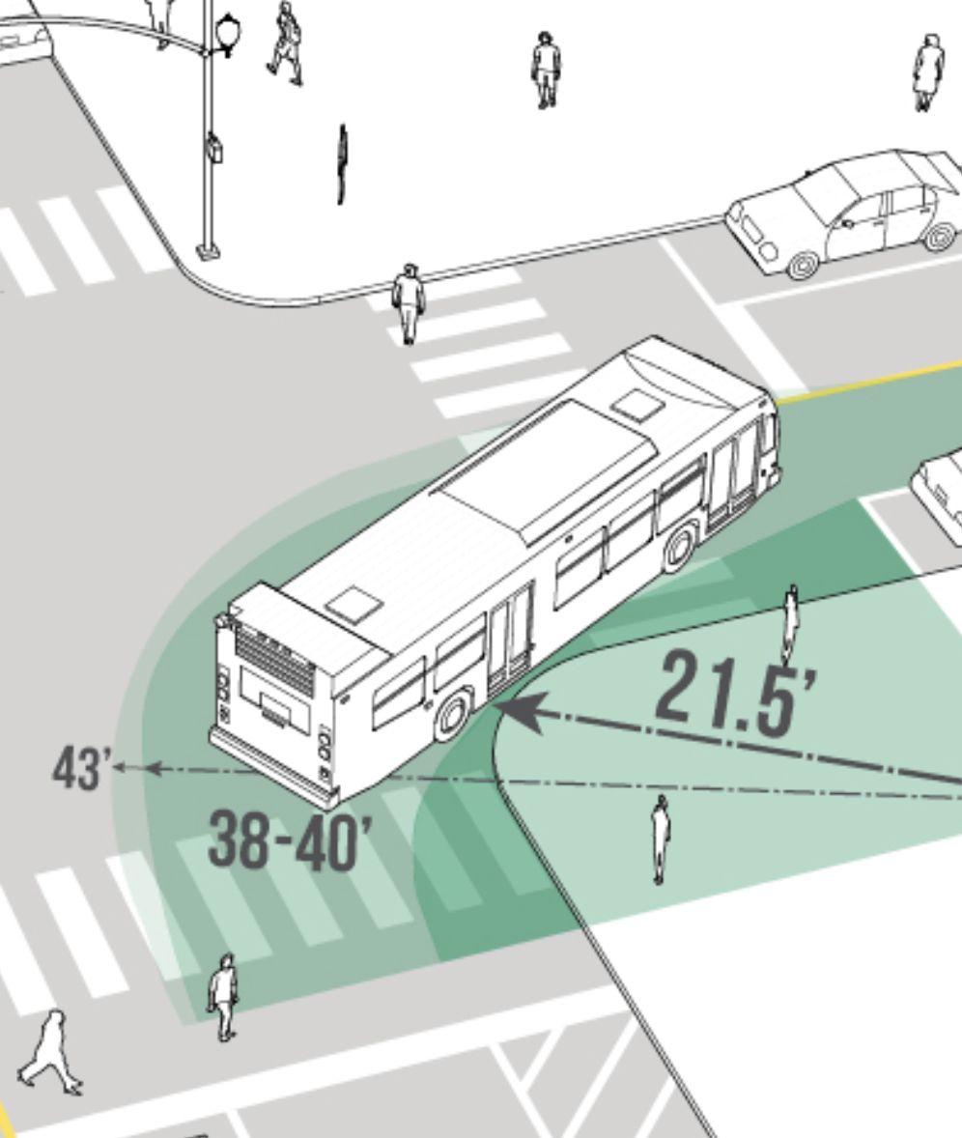
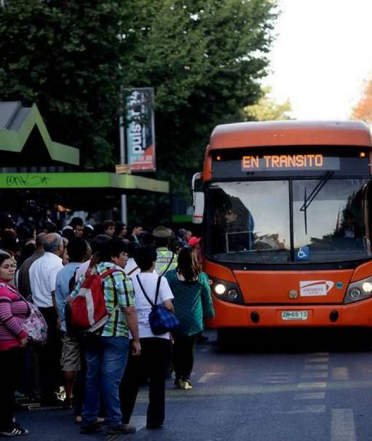
Risk of public transport buses
Heavy vehicles
Blind spots
High turning radius
Circulate in area with high density of pedestrians and cyclists

Slide 6
History of public transport buses in Santiago
Source: Tapia, 2023
6

Slide 7
Goals

Slide 8
Goals
Study and offer solutions to prevent road crashes involving public transport buses in Santiago de Chile, particularly crashes involving pedestrians and cyclists.
Specific goals:
What is the impact public transport buses on road safety in Santiago?
Which risk factors increase the severity of road crashes between public transport buses and pedestrians in Santiago?
Which risk factors increase the severity of road crashes between public transport buses and cyclists in Santiago?
Are female drivers less likely to be involved in fatal road crashes?
What were the effects on road safety of the Transantiago implementation?
What are the effects on road safety of the Red standard roll out?
How does Santiago compare to other cities in term of public transport bus road safety?
Which strategies and measures could be put in place to improve road safety of public transport buses?

Slide 9
Literature

Slide 10
Literature and research gaps
Increasing interest in the topic
Research gap on pedestrian/bus and cyclist/bus crashes in Santiago de Chile
Research gap on road safety impact of public transport buses in Santiago
Number of publications on the Scopus platform related to crashes involving pedestrians, cyclists and buses (Scopus, 2023).
10

Slide 11
Crash severity models - Risk factors
Speed
Road user gender
Bus Driver Gender
Road user age
Days of week and weekends
Time of the day
Nighttime and lighting conditions
Weather
Road characteristics
Manoeuvres
Crash severity models - Risk factors
Crash severity models - Risk factors
Crash severity models - Risk factors
Crash severity models - Risk factors
Road crash severity
11

Slide 12
Crash Severity Models
Logit models
Binary Probit models
Ordered Probit Models
Multinomial Logit Models:
$$P_{n}\left(i\right)= \frac{e^{β_{i} X_{i}}}{\sum_{j}{e^{β_{j} X_{j}}}}$$
Where:
$X_{i}$ a vector of explanatory variables that determine the severity
$β_{i}$a vector of estimable coefficients for injury outcome I
$P_{n}\left(i\right)$probably of crash n to result in severity i
12

Slide 13
Road safety policies evaluation
Pre/post study
As the road crash policy can apply to an entire country or city, it is sometime not possible to have a control group
Control for effects like:
Vehicle Kilometres travelled
Measure exposure
Traditionally methods account for exposure through linear crash rate
Not always the case – need to verify this
Speed
The relationship between speed and road safety is the same at driver level as at the aggregate level (mean traffic speed)
Power model and exponential model
13

Slide 14
Methodology

Slide 15
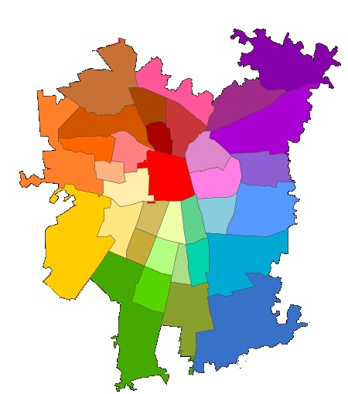
Data
Study area
Operation area of the Public Transport Authority of Santiago de Chile (DTPM)
Province of Santiago de Chile (32 municipalities)
Puente Alto
San Bernardo
2017-2021
User information
Crash condition information
Crash location information
Involved driver information
2002-2021
Is public transport involved
Road crash data
Recorded by the Chilean Police
Reformatted by the Chilean commission for road Safety (CONASET)
15

Slide 16
Descriptive statistics
Road crash severity data presentation - Chi-square test for each parameters
Severity crashes between pedestrians and public transport buses
Severity crashes between cyclists and public transport buses
Fatal pedestrian crashes with or without public transport buses involved
Fatal cyclist crashes with or without public transport buses involved
Fatal pedestrian or cyclist crashes with public transport buses
Crash rate
Test of proportion to compare crash rates
Used for bus driver gender
16

Slide 17
Road crash severity models
For pedestrian/bus and cyclist/bus road crashes - 3 Multinomial Logit Models
Parameters statistically significant at 10%
Parameters statistically significant at 20%
All parameters
Akaike Information Criterion (AIC) to compare the goodness of fit:
$$AIC=2K−2\ln{(LL)}$$
Where:
K the number of independent variables in the model
LL the log-likelihood estimate
17

Slide 18
Road safety policies evaluation
Transantiago system implementation (2005 – 2007)
Pre/post on number of fatalities (2002-2004 compared to 2008-2012)
Control: Fatal crashes not involving public transport buses as control group
Red standard roll out (2017 – ongoing)
Relationship between fatality rate and proportion of new buses
Control: Average speed/kilometres travelled by public transport bus
(Impact of COVID 19 and 2019 Protests)
$$R=\left(a \left(k_{New buses }\right)+ b \left(1−k_{New buses }\right)\right). e^{ βV}$$
Where:
R rate of road crash fatalities involving a bus from public transport by kilometres travelled by public transport buses (in fatalities by 1 million kilometres travelled)
$k_{New buses}$ the proportion of public buses with the new standard (in %)
$V$yearly average speed during working days (in km/h)
$β$ coefficient for the speed to be determined by the model
a and b will be parameters to be determined by the model. “b” will represent the level of safety of old bus fleet and “a” the new bus fleet
18

Slide 19
Results

Slide 20
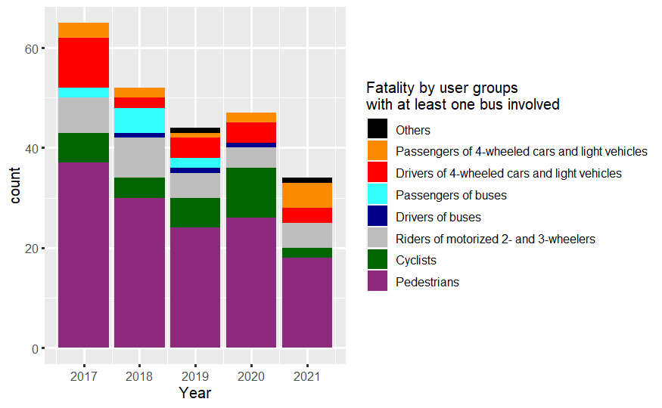
Impact of public transport buses in Santiago
User type | Total Fatalities | Fatalities with Public Transport involved
Pedestrians | 515 | 135 (26.2%)
Cyclists | 104 | 28 (26.9%)
Riders of motorized 2- and 3-wheelers | 309 | 29 (9.4%)
Drivers of 4-wheeled cars and light vehicles | 161 | 23 (14.3%)
Passengers of 4-wheeled cars and light vehicles | 109 | 13 (11.9%)
Drivers of buses | 7 | 3 (42.9%)
Passengers of buses | 11 | 9 (81.8%)
Drivers and passengers of heavy trucks | 13 | 0 (0.0%)
Others | 14 | 2 (14.3%)
Total | 1243 | 242 (19.5%)
Important impact of public transport on pedestrians and cyclists safety
(Answers specific goal 1)
Santiago (2017-2021)
20

Slide 21
Severity Models - results
Pedestrians/public transport buses (Answer specific goal 2)
Crashes are more likely to be fatal when they involve:
Male pedestrians
Older pedestrians (aged 65 of more)
Older bus driver (45 years old or older)
Bus restarting (from a bus stop)
Occur at night
Cyclists/public transport buses (Answer specific goal 3)
Crashes involving a male cyclist are more likely to be severe
Crashes occurring at night are more likely to be fatal
21

Slide 22
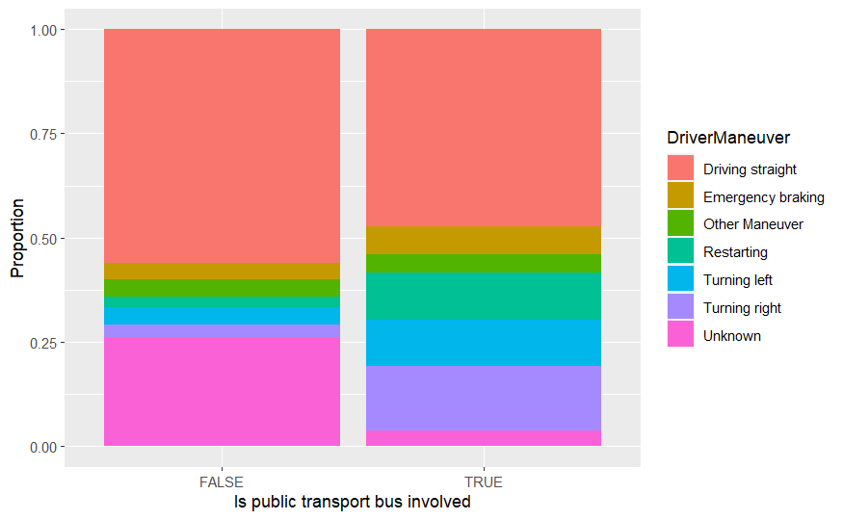
Risk Factors – Bus driver manoeuvre
Pedestrian fatalities involving public transport buses are more likely to occur when the bus restart or turn
Santiago (2017-2021)
22

Slide 23
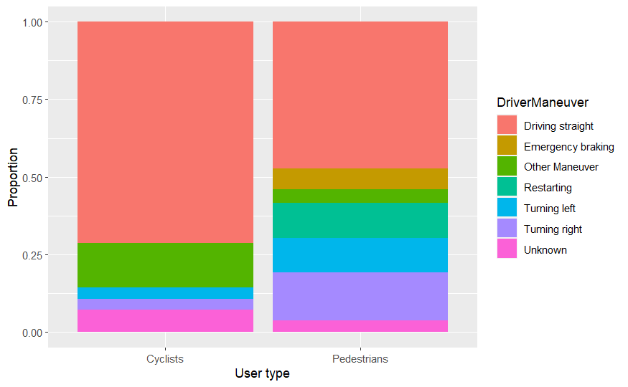
Risk Factors – Bus driver manoeuvre
Cyclist fatalities involving public transport buses are more likely to occur when the bus driver goes straight
Santiago (2017-2021)
23

Slide 24
Bus driver gender
Women represent:
3.90% of the drivers
Involved in 1.49% of the pedestrian fatalities
Female bus drivers are 62.8% less likely to be involved in a pedestrian fatality than male drivers (p-value = 0.05873)
 | Gender | 2014 | 2015 | 2016 | 2017 | 2018 | 2019 | 2020 | 2021 | 2014-2021 Driver Year
Number bus driver | Male | 17029 | 17868 | 18466 | 17535 | 17425 | 19192 | 15620 | 14781 | 137916
 | Female | 264 (1.53%) | 325 (1.79%) | 485 (2.56%) | 599 (3.30%) | 965 (5.25%) | 1271 (6.21%) | 803 (4.89%) | 889 (5.67%) | 5601 (3.90%)
Number of bus drivers involved in a pedestrian fatality | Male | 45 | 41 | 48 | 35 | 30 | 23 | 25 | 18 | 265
 | Female | 0 (0.00%) | 1 (2.38%) | 0 (0.00%) | 1 (2.78%) | 0 (0.00%) | 1 (4.17%) | 1 (3.85%) | 0 (0.00%) | 4 (1.49%)
Rate of male driver involved in pedestrian fatality for 10.000 drivers | Male | 26.4 | 22.9 | 26.0 | 20.0 | 17.2 | 12.0 | 16.0 | 12.2 | 19.2
 | Female | 0.0 | 30.8 | 0.0 | 16.7 | 0.0 | 7.9 | 12.5 | 0.0 | 7.1
(Answers specific goal 4)
24

Slide 25
Policies evaluation
Implementation Transantiago
Red standard
roll out
25

Slide 26
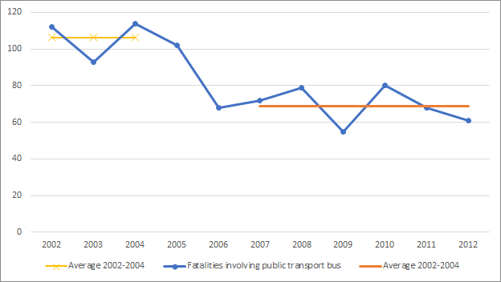
Policy evaluation - Transantiago
Road crashes involving public transport buses:
35.5% fatalities decrease
77.8% bus occupant fatalities decrease
Using the control group road crashes involving public transport buses:
19.5% fatalities decrease
72.3% bus occupant fatalities decrease
Traffic fatalities not involving public transport buses decreased by 19.8%
Answers specific goal 5
26

Slide 27
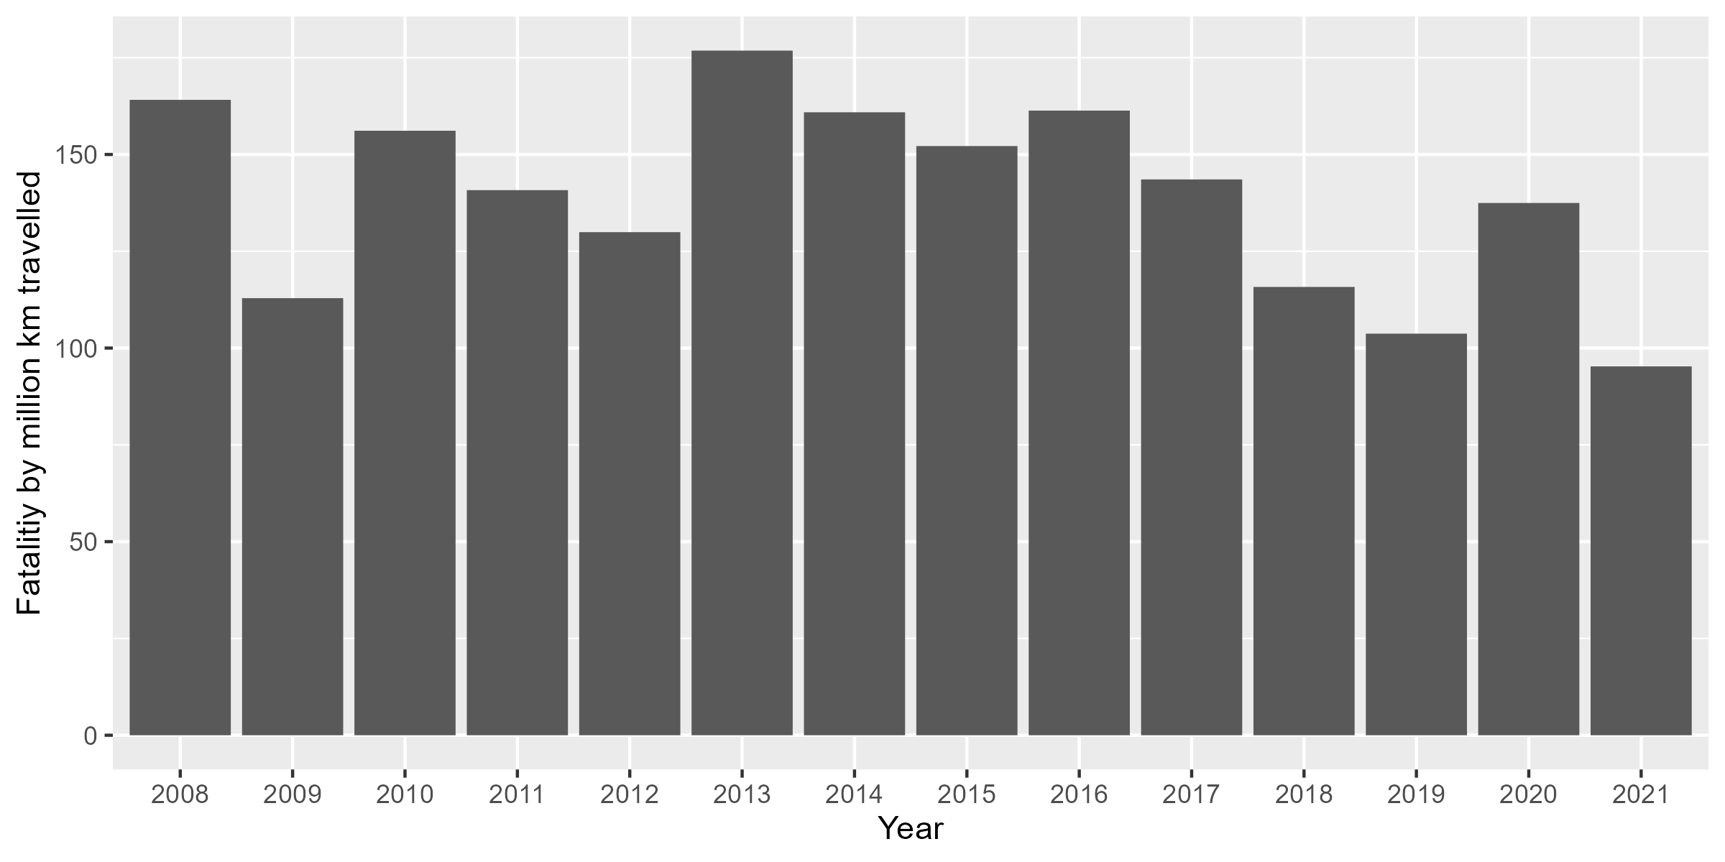
Policy evaluation – Red standard roll out
Period 2008-2016 , linear relation between
Crash fatalities involving bus
Bus kilometres travelled
(Adjusted R-squared = 0.9831)
Between the periods 2008-2016 and 2017-2021:
47.6% decrease in average number of fatalities involving buses
26.4% decrease in rate of fatalities by bus VKT
No significant changes in fatalities in road crashes not involving buses
27

Slide 28
Policy evaluation – Red standard roll out
Model fatality rate 2016-2021
controlling for:
Bus kilometres travelled
Average bus speed
Formula:
R $=\left(0.3820774 \left(k_{New buses }\right)+ 2.599946 \left(1−k_{New buses }\right)\right). e^{ 0.202736573 V}$
Model fits very well the data (R-Squared 0.953960567)
Seems to overestimate the effect of the bus roll out (85.3% with full roll out and constant average speed)
Other factors might also play a role:
The impact of COVID-19 pandemic
The impact of the 2019 Chilean protest
New bus lane and automatic enforcement
The increase of number of female drivers
Professionalisation of bus operators
Maintenance of Transantiago buses
Answers partly specific goal 6
28

Slide 29
Comparison with other Chilean cities
Higher impact of buses on road safety in other Chilean cities
Crashes rate similar for crashes not involving public transport buses
No reduction of fatalities involving buses in Greater Valparaíso between 2002-2011 and 2012-2021
Similar proportion in those cities than in Santiago before Transantiago
Partly answers specific goal 7
 | Santiago | Greater Concepción | Greater Valparaíso
Proportion of pedestrian fatalities involving a public transport bus | 26.2% | 30.8% | 38.8%
Proportion of cyclist fatalities involving a public transport bus | 26.9% | 50.0% | 75.0%
Proportion of traffic fatalities involving a public transport bus | 19.5% | 25.2% | 25.3%
29

Slide 30
Recommendations

Slide 31
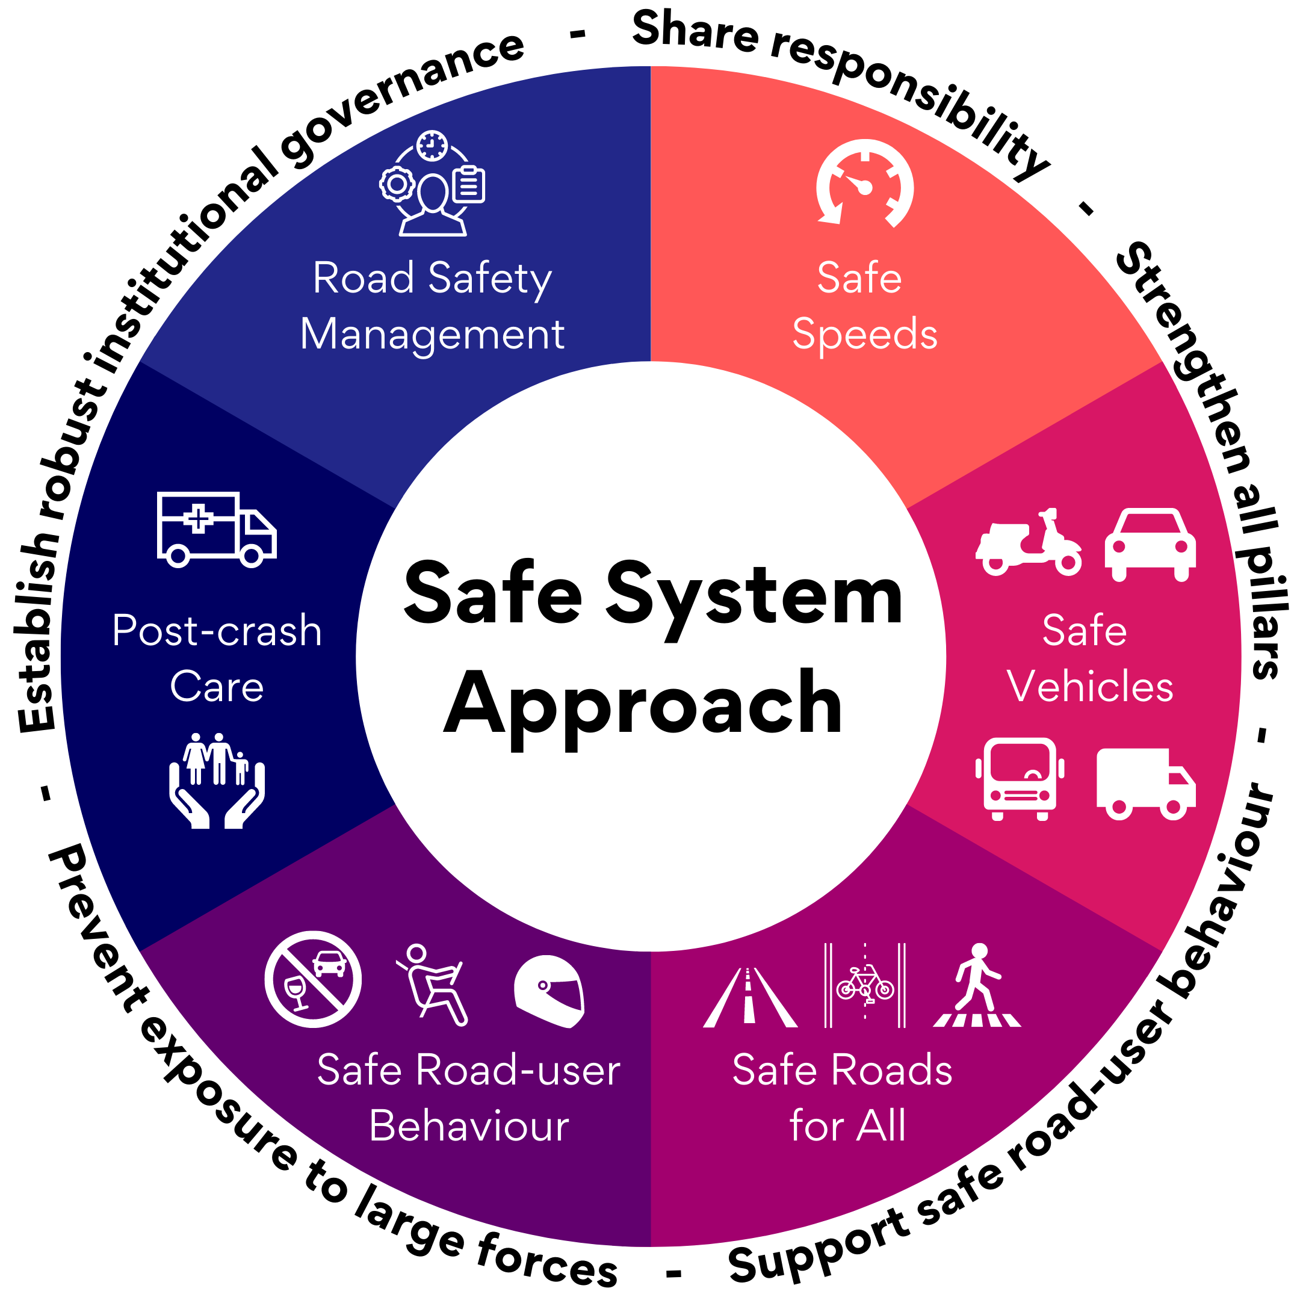
Recommendations
6 pillars
22 measures
Relevant stakeholders in Santiago
Answers specific goal 8

Slide 32
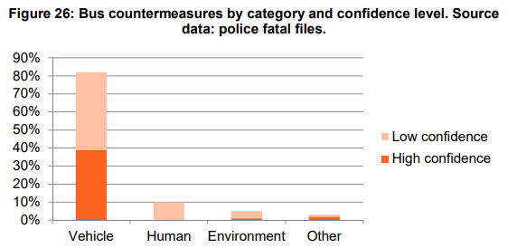
Safe Vehicles
Source: Edwards, A. et al., 2018, Analysis of bus collisions and identification of countermeasures
32

Slide 33
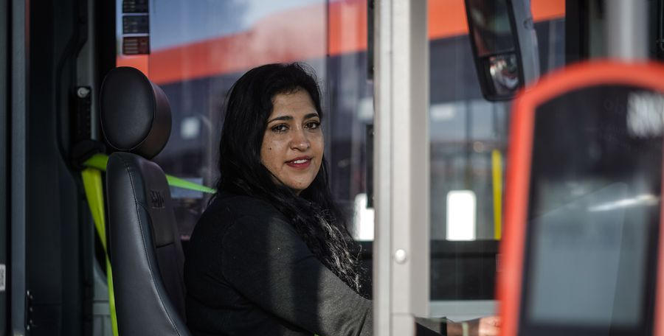
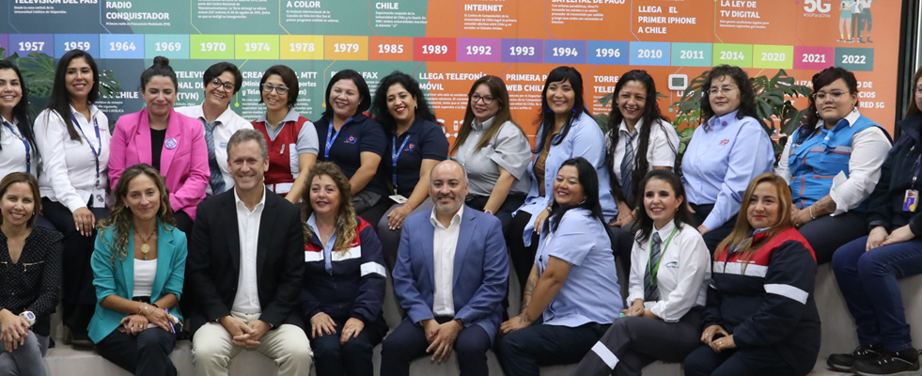
Women drivers
Maintain and extend the efforts to promote female bus drivers in the public transport in Santiago

Slide 34
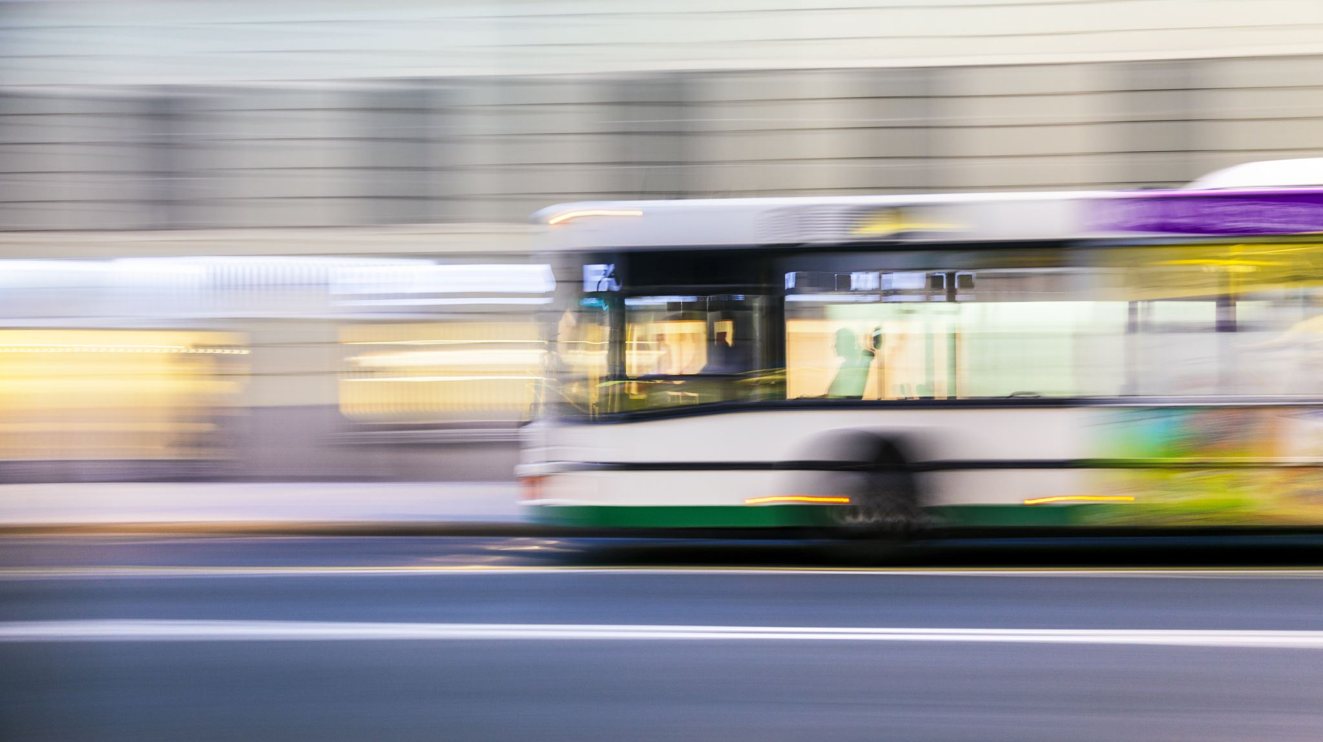
Conclusions
Public transport buses have a significant impact on road safety in Santiago de Chile and other cities in Chile
Necessity for Santiago and other cities in Chile to improve the road safety of their public transport system.
Models have provided insights on the risk factors of road crashes involving public transport buses
Recommendations to help public authorities make public transport safer in Santiago and in the rest of Chile

Slide 35
Thank you

Slide 36
In memory of: Valeria Gazzano Archiles Isabel La Cruz Pappaterra Eugenia La Cruz Pappaterra

Slide 37
Annexes

Slide 38
Pedestrians/buses Severity
 | Fatal injuries (N=135) | Severe injuries (N=504) | Slight injuries or pedestrians unhurt (N=694) | Total pedestrians impacted (N=1333) | p value
Gender |  |  |  |  | < 0.001
Male | 98 (72.6%) | 274 (54.4%) | 330 (47.6%) | 702 (52.7%)
Female | 37 (27.4%) | 230 (45.6%) | 364 (52.4%) | 631 (47.3%)
Age Range |  |  |  |  | < 0.001
Unknown | 5 | 12 | 20 | 37
0 to 9 years | 2 (1.5%) | 11 (2.2%) | 30 (4.5%) | 43 (3.3%)
10 to 17 years | 3 (2.3%) | 38 (7.7%) | 58 (8.6%) | 99 (7.6%)
18 to 29 years | 15 (11.5%) | 105 (21.3%) | 178 (26.4%) | 298 (23.0%)
30 to 44 years | 26 (20.0%) | 98 (19.9%) | 150 (22.3%) | 274 (21.1%)
45 to 64 years | 48 (36.9%) | 158 (32.1%) | 178 (26.4%) | 384 (29.6%)
65 years and above | 36 (27.7%) | 82 (16.7%) | 80 (11.9%) | 198 (15.3%)
is Weekend? |  |  |  |  | 0.119
Weekday | 108 (80.0%) | 404 (80.2%) | 586 (84.4%) | 1098 (82.4%)
Weekend | 27 (20.0%) | 100 (19.8%) | 108 (15.6%) | 235 (17.6%)
Weather Condition |  |  |  |  | 0.597
Bad condition | 9 (6.7%) | 47 (9.3%) | 58 (8.4%) | 114 (8.6%)
Good condition | 126 (93.3%) | 457 (90.7%) | 636 (91.6%) | 1219 (91.4%)
Day or Night? |  |  |  |  | 0.009
Night | 56 (41.5%) | 169 (33.5%) | 200 (28.8%) | 425 (31.9%)
Day | 79 (58.5%) | 335 (66.5%) | 494 (71.2%) | 908 (68.1%)

Slide 39
Models AIC
 | AIC | Delta AIC | Number of independent variables | Log likelihood
Multinomial logit (all parameters) | 1653.69 | 0 | 64 | -757.64
Multinomial logit (10% significance parameters) | 1705.28 | 51.59 | 28 | -823.74
Multinomial logit (20% significance parameters) | 1713.65 | 59.96 | 44 | -810.57
 | AIC | Delta AIC | Number of independent variables | Log likelihood
Multinomial logit (10% significance parameters) | 603.9 | 15.46 | 6 | -295.83
Multinomial logit (20% significance parameters) | 609.53 | 21.09 | 10 | -294.46
Multinomial logit (all parameters) | 642.24 | 53.8 | 64 | -241.3

Slide 40
Severity Model – Cyclists/buses
Outcome | Characteristic | Odds Ratio | Confidence Interval | p-value | Outcome | Odds Ratio | Confidence Interval | p-value
Fatal | Gender |  |  |  | Severe
 | Male | — | — |  |  | — | —
 | Female | 1.42 | 0.51, 3.99 | 0.5 |  | 0.61 | 0.35, 1.05 | 0.077
 | Day or Night?
 | Night | — | — |  |  | — | —
 | Day | 0.19 | 0.07, 0.50 | <0.001 |  | 0.89 | 0.53, 1.49 | 0.7

Slide 41
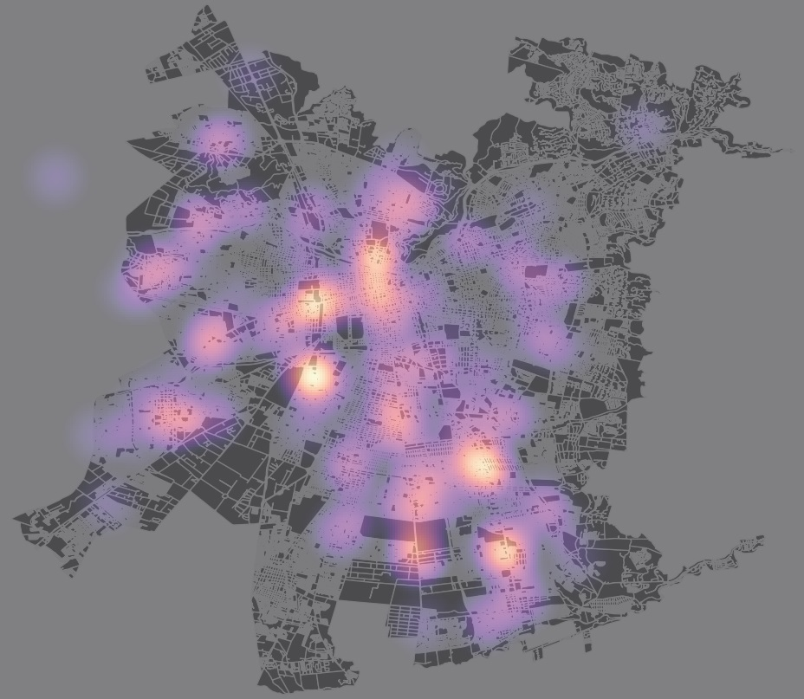
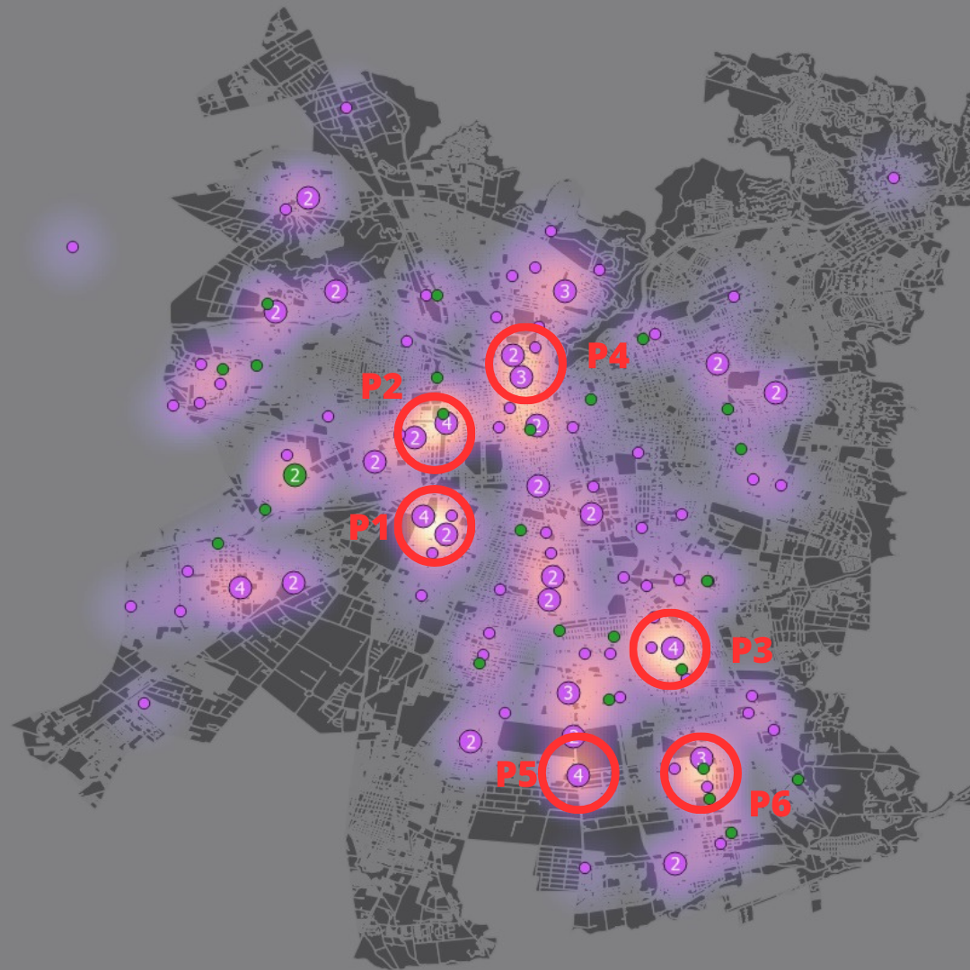
Fatal crash locations
41

Slide 42
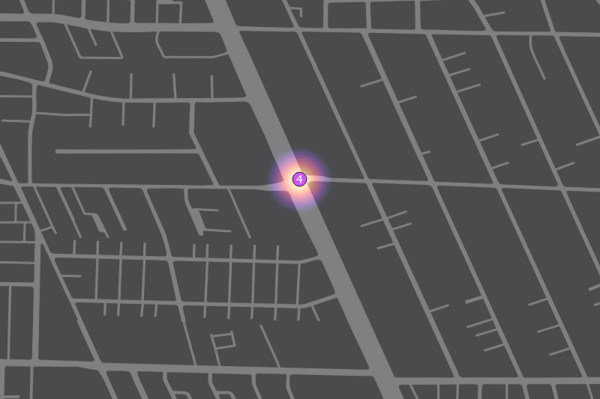
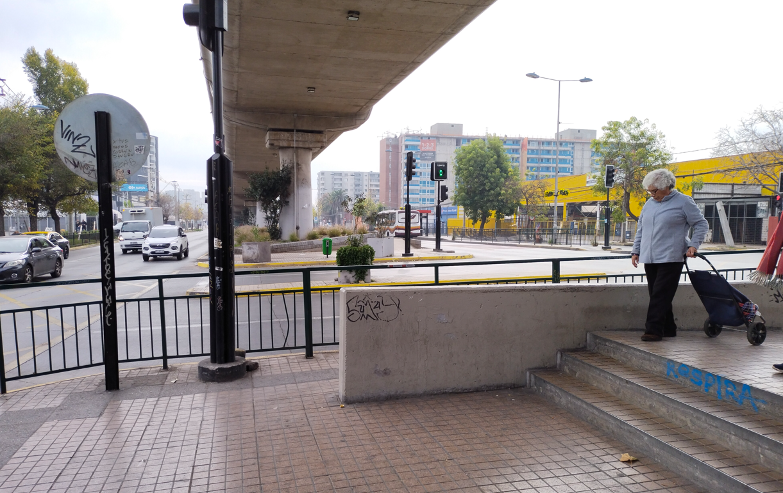
Fatal crash locations - Example
4 fatal pedestrian/bus crash in the exact same location
Intersection incomplete
Low pedestrian space
High pedestrian demand and delay
High pedestrian risk
42

Slide 43
Comparison with other Chilean cities
 | Santiago | Greater Concepción | Greater Valparaíso
Population (inhabitants) | 6,782,636 | 1,011,161 | 1,009,370
Pedestrian fatalities involving a public transport bus | 135 | 36 | 33
Pedestrian fatalities | 515 | 117 | 85
Proportion of pedestrian fatalities involving a public transport bus | 26.2% | 30.8% | 38.8%
Rate of pedestrian fatalities involving a public transport bus (rate for 1 million inhabitant) | 19.9 | 35.6 | 32.7
Rate of pedestrian fatalities (rate for 1 million inhabitant) | 75.9 | 115.7 | 84.2
Cyclist fatalities involving a public transport bus | 28 | 4 | 3
Cyclist fatalities | 104 | 8 | 4
Proportion of traffic fatalities involving a public transport bus | 26.9% | 50.0% | 75.0%
Rate of cyclist fatalities involving a public transport bus (rate for 1 million inhabitant) | 4.1 | 4.0 | 3.0
Rate of cyclist fatalities (rate for 1 million inhabitant) | 15.3 | 7.9 | 4.0
Traffic fatalities involving a public transport bus | 242 | 55 | 46
Total fatalities | 1243 | 218 | 182
Proportion of traffic fatalities involving a public transport bus | 19.5% | 25.2% | 25.3%
Rate of traffic fatalities involving a public transport bus (rate for 1 million inhabitant) | 35.7 | 54.4 | 45.6
Rate of traffic fatalities (rate for 1 million inhabitant) | 183.3 | 215.6 | 180.3
Higher impact of buses on road safety in other Chilean cities
No reduction of fatalities involving buses in Greater Valparaíso between 2002-2011 and 2012-2021
Similar rate in those cities than in Santiago before Transantiago
Partly answers specific goal 8
43

Slide 44
Comparison with Greater London
 | Santiago | Greater London
Population | 6,782,636 | 8,797,000
Traffic fatalities involving a bus from public transport | 242 | 42
Total fatalities | 1243 | 539
Proportion of traffic fatalities involving a bus from public transport | 19.5% | 7.8%
Rate of traffic fatalities involving a bus from public transport (rate for 1 million inhabitant) | 35.7 | 4.8
Rate of traffic fatalities not involving a bus from public transport (rate for 1 million inhabitant) | 147.6 | 56.5
Rate of traffic fatalities (rate for 1 million inhabitant) | 183.3 | 61.3
The rate of traffic fatalities in Greater London is 3 times lower than in Santiago
7.5 lower for traffic fatalities involving public transport buses
Partly answers specific goal 8
44

Slide 45
Road Safety Management
Measure | Possible involved stakeholders in Santiago
Coordinate the road safety work of operators | DTPM, bus operators
Set realistic and long-term targets | DTPM, CONASET
Promote traffic safety management initiatives | DTPM
Crease a safe network structure and bus routes | DTPM, bus operators

Slide 46
Safe speed
Measure | Possible involved stakeholders in Santiago
Create a speeding monitoring system | DTPM, bus operators
Implement a geofencing system | DTPM, bus operators, bus suppliers
Intelligent Speed Assistance | DTPM, bus operators, bus suppliers
Reduce speed limits | Transport Ministry, Regional Government, DTPM, CONASET, municipalities

Slide 47
Safe Vehicles
Measure | Possible involved stakeholders in Santiago
Improve vision standards for buses | DTPM, bus operators, bus suppliers
Implement system for the detection of pedestrians and cyclists | DTPM, bus operators, bus suppliers
Implement Advanced Emergency Braking system | DTPM, bus operators, bus suppliers
Improve Vulnerable Road User (VRU) Frontal Crashworthiness | DTPM, bus operators, bus suppliers
Make bus interior occupant friendly | DTPM, bus operators, bus suppliers
Implement driver distraction warning systems | DTPM, bus operators, bus suppliers

Slide 48
Safe road user behaviours
Measure | Possible involved stakeholders in Santiago
Create a driver monitoring system | DTPM, bus operators
Provide driver training | DTPM, bus operators
Reduce driver stress and promote a safety culture | DTPM, bus operators
Promote women drivers | DTPM, bus operators

Slide 49
Safe roads for all
Measure | Possible involved stakeholders in Santiago
Separate buses from other road users: Create dedicated bus infrastructure Create dedicated bicycle/pedestrian facilities with conflict-free traffic intersections | Transport Ministry, Regional Government, DTPM, CONASET, municipalities
Provide safe access to public transport | Transport Ministry, Regional Government, DTPM, CONASET, municipalities

Slide 50
Safe post-crash care
Measure | Possible involved stakeholders in Santiago
Implement automatic Emergency alerting from bus | DTPM, bus operators
Investigate road crashes | DTPM, bus operators, CONASET

